Slide 1
Getting Started with Microsoft Identity

Slide 2

Overview
Overview of Microsoft Identity
ID tokens
Access tokens

Slide 3

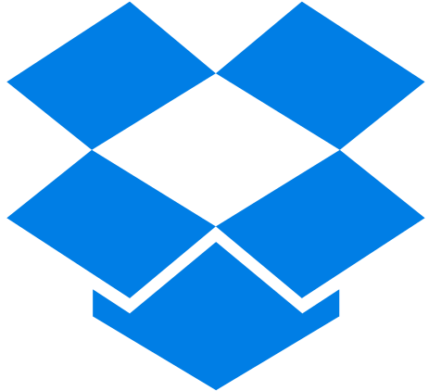




Digital Transformation is about connections
Employees
Customers
Partners
Distributors
Suppliers
Devices
Things
Notes:
In today's world, physically protected networks aren't as common as they once were. Even your on-premises networks aren’t as secure as you think they are. The configuration of today's networks are driven by the needs of users and business that has changed over time.
Organizations can't assume users will be in one place, rather they are on both internal and/or external networks. Users don't access networks with one device either; they have a myriad of devices and types of software architectures they use including on-premises apps, SAAS apps, mobile apps, and so on.
How are you as a developer supposed to properly secure your applications and your user's access to information across so many scenarios?

Slide 4
Manage and secure with identity as the control plane
Cloud Apps
Partners & Customers
Employees
Identity
On-premises apps
Devices
Notes:
The answer is to use an identity provider as your control plane. By using your identity provider, your application and the organization can decide who gets to do what, when they get to do it, how they got to do it.
Access and control are important as well as that they have the level of sophistication available to them.
It might be OK if somebody is working on sensitive financial information when they are on the company network at the office. However, it might not be OK for them to access that information from an internet café on the other side of the world where the organization is unaware of the user's environment.
The idea that your identity provider can help you provides the right control plane for your application.

Slide 5
Users
Identity
Resources
Policies
Notes:
The identity provider is where the users, resources, and policies intersect within your organization.
To a developer, you want your application to be accessible to the highest number of users who should have access to it. Independent software vendors (ISVs) are especially interested in the greatest reach in order to grow their businesses.
You also need access to those resources the users need access to including mail, information about me. Access to these resources is important in building valuable solutions for your customers.
A problem you need to address is how will all these users access their resources but in a way that complies with whatever policies and security requirements the enterprise demands.
How do you make sure that your application follows the right policies? Each enterprise will have a different point of view on what the policy should be
This is where identity platform is here to help. The goal of Microsoft Identity is to make it easy for you, to address the largest number of users, and the most valuable amount of information in a secure way that satisfies the policies of those enterprises.
Let's look at how Microsoft Identity approaches users, resources, and policies.

Slide 6
Microsoft Identity Services
Millions of organizations, billions of identities
1.34 B
844M
246 M
22.5M
45B
identities
Microsoft Account Monthly Active Users
Azure AD
Monthly Active Users
organizations
daily authentications & authorizations
Sep 14, 2019
Notes:
Microsoft Identity includes three solutions for addressing the largest number of users.
Microsoft is one of the largest identity providers. Azure Active Directory manages over a billion identities, and billions of authentications a day. Over 20 million organizations, including most Fortune 500 companies, use Azure Active Directory.
Microsoft Identity offers two additional solutions for partners and customers.

Slide 7
External collaboration using B2B
Contoso
Fabrikam
Contoso Content
User A
User B
User B
Notes:
Azure AD business to business (B2B) enables an organization in Azure AD to securely share files and resources with another organization in Azure AD.

Slide 8








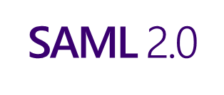


Azure Active Directory B2C
Any SAML provider
Social IDs
Microsoft Azure Active Directory
Analytics
Business & Government IDs
Apps
contoso
Customers
Business
Securely authenticate your customers using their preferred identity provider
Capture login, preference, and conversion data for customers
Provide branded (white-label) registration and login experiences
Notes:
Azure AD Business to Customer (B2C) enables an organization to provide customer-facing apps that enable users to sign with an identity they already have, such as a Microsoft Account, Gmail, Facebook, or Twitter account or create an account for the solution.​

Slide 9
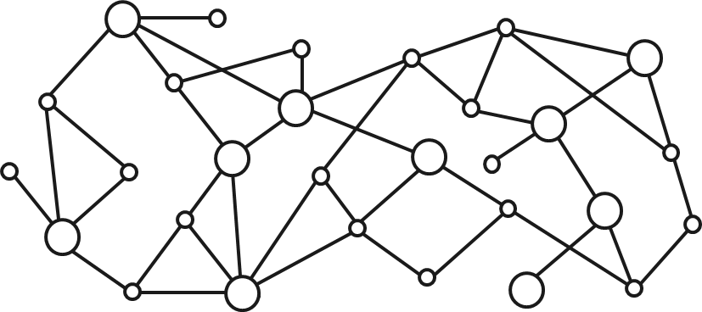
Gateway to your data in the Microsoft cloud
Your app
Web Apps
Device & Native
Apps
Bots
Background
processes
1
Gateway
Microsoft Graph
Office 365
Windows 10
Enterprise Mobility + Security
Your or your customer’s data
Microsoft identity
Rich content
Deep insights
Real-time updates
Notes:
Microsoft Graph is the gateway to all your data in the Microsoft Cloud. From Office 365, Enterprise Mobility + Security to Windows 10, Microsoft Graph enables developers to build applications that provide users access to their data. Developers and users can access their data with Microsoft Graph by authenticating and authorizing users with Microsoft Identity.

Slide 10



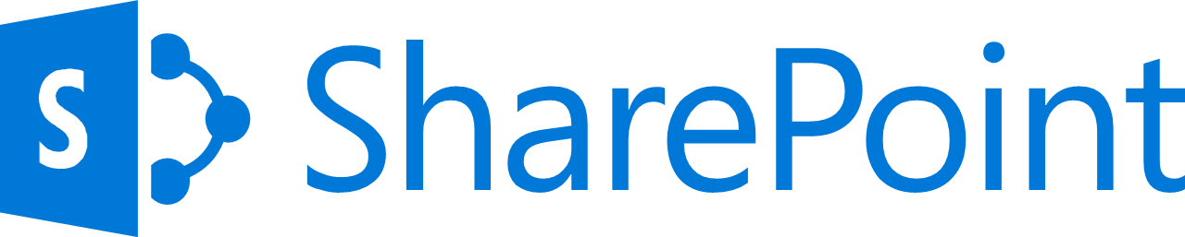
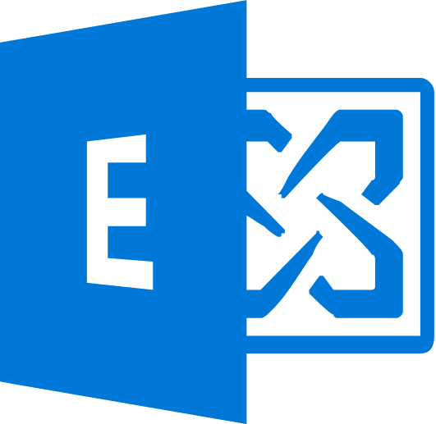



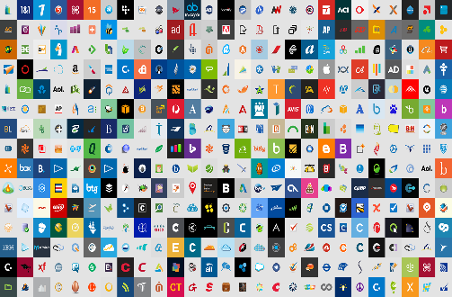


Azure AD
ADFS
Conditions
Controls
MSA
40TB
Google ID
Employee & Partner Users and Roles
Allow/block
access
Microsoft Cloud
Android
Session Risk
iOS
Machine learning
3
MacOS
Trusted & Compliant Devices
Limited
access
Microsoft Cloud App Security
Windows
Windows Defender ATP
Real time Evaluation
Engine
Require
MFA
Cloud SaaS apps
Geo-location
Physical & Virtual Location
Force
password
reset
Corporate Network
******
Policies
Effective policy
Client apps & Auth Method
Block legacy authentication
Browser apps
Client apps
On-premises apps
Notes:
The third element of Microsoft Identity is policies. Policies have become complicated with users accessing resources from different networks and devices. The threat matrix depending on how a user is accessing a resource is complex. Various combinations of different users using different devices pose different risks to the organization.
Microsoft Identity is built to support this complex and dynamic threat matrix. One policy can be applied when a user is on a trusted corporate network using their company issued laptop, while another policy can apply to the same user when they access the same resource from home on their personal tablet.
By relaying on Microsoft Identity to handle these complex policies, you don't have to implement the complex logic in your custom applications.

Slide 11
ID tokens
Notes:
So far, we've looked at what Microsoft Identity is from a high level. As a developer, when you build an application, you will ultimately request tokens from Microsoft Identity to identify a user and authorize them to use an application with specific permissions. Let's look at the different tokens you will use.

Slide 12
OpenID Connect & ID tokens
Open ID Connect extends OAuth 2.0
Uses OAuth 2.0’s authorization protocol as an authentication protocol
Enables developers to implement single sign-on using OAuth
ID token
Security token that clients can use to verify identity of user
Contains basic profile information about the user
Claims in ID tokens can be used for the user experience, keys in DB’s & providing access to
client applications
Notes:
The first type of token is an ID token that is made available via Microsoft Identity's support of the OpenID Connect protocol.
OpenID Connect extends the OAuth 2.0 authorization protocol to use as an authentication protocol, OpenID Connect enables you to implement single sign-on using OAuth in your applications. It introduces the concept of an ID token.
An ID token is a security token that allows the client to verify the identity of the user. The ID token also gets basic profile information about the user. Because OpenID Connect extends OAuth 2.0, apps can securely acquire access tokens, which can be used to access resources that are secured by an authorization server.
The claims included within an ID token can be used for the user experience within your application, as keys in a database, and providing access to the client application.
ID tokens for a Microsoft identity are JSON web tokens (JWT). These ID tokens consist of a header, payload, and signature. The header and signature are used to verify the authenticity of the token, while the payload contains the information about the user requested by your client.

Slide 13
ID token claims
ID tokens contain the claims in the payload
Noteworthy Claims | Description
aud | Identifies the intended recipient of the token. In id_tokens, the audience is your app's Application ID, assigned to your app in the Azure portal.
iss | Identifies the security token service (STS) that constructs and returns the token, and the Azure AD tenant in which the user was authenticated.
iat | "Issued At" indicates when the authentication for this token occurred.
idp | Records the identity provider that authenticated the subject of the token.
nbf | The "nbf" (not before) claim identifies the time before which the JWT MUST NOT be accepted for processing.
exp | The "exp" (expiration time) claim identifies the expiration time on or after which the JWT MUST NOT be accepted for processing.
c_hash | The code hash is included in ID tokens only when the ID token is issued with an OAuth 2.0 authorization code.
at_hash | The access token hash is included in ID tokens only when the ID token is issued with an OAuth 2.0 access token.
preferred_username | The primary username that represents the user.
email | The email claim is present by default for guest accounts that have an email address and when specified by the developer, for users with email provided by the resource tenant.
name | The name claim provides a human-readable value that identifies the subject of the token.
nonce | The nonce matches the parameter included in the original /authorize request to the IDP.
oid | The immutable identifier for an object in the Microsoft identity system, in this case, a user account.

Slide 14
Obtaining ID tokens
Developers should use a well-maintained OpenID Connect Library like the Microsoft Authentication Library (MSAL) to obtain ID Tokens. For example in MSAL JS​
​
var myMSALObj = new Msal.UserAgentApplication(msalConfig);​
myMSALObj.loginPopup("User.Read").then(function (loginResponse) {​
…​
}​
Notes:
It is important for developers, whenever possible, to use a well-maintained Open ID Connect library. While Microsoft Identity is built on open standards like OAuth2 and Open ID Connect, fully implementing these protocols is time consuming and complicated. It is also required that any implementation of these standards be kept up-to-date with the latest recommendations to ensure the implementation is as secure as possible. ​
When your web app needs to authenticate the user, it can direct the user to the Microsoft identity platform /authorize endpoint using an Open ID Connect library. ​
At this point, the user is prompted to enter their credentials, enter a Multi-factor, use a FIDO2 compatible device, or perhaps use a password less experience using Microsoft Authenticator or Windows Hello to complete the authentication. All of these options are handled by the platform without any additional code from the developers. The Microsoft identity platform endpoint verifies that the user has consented to the permissions indicated in the scope parameter. If the user hasn't consented to any of those permissions, the Microsoft identity platform endpoint prompts the user to consent to the required permissions. You can read more about permissions, consent, and multi-tenant apps.​
After the user authenticates and grants consent, the Microsoft identity platform endpoint returns a response to your app at the indicated redirect URI.​

Slide 15
Access tokens
Notes:
Many web apps need to not only sign the user in, but also to access a web service on behalf of the user by using OAuth. This scenario combines OpenID Connect for user authentication while simultaneously getting an authorization code that you can use to get access tokens if you are using the OAuth authorization code flow.

Slide 16
Access tokens
ID tokens are used to identify users
Access tokens are used to authorize a range of operation against an API for the application on behalf of the user
Notes:
Many web apps need to not only sign the user in, but also to access a web service on behalf of the user by using OAuth. Applications request access tokens from Microsoft Identity to use when calling a web service. ​
*Access tokens* enable clients to securely call APIs protected by Azure AD. Applications should never inspect or validate an access token. Access tokens must only be passed to the API.
Access tokens are created based for the audience of the token, meaning the API that owns the scopes in the token. ​

Slide 17
Obtaining access tokens
Always try the silent token acquisition before attempting interactive token acquisition​
​
​try​{​
result = await app.AcquireTokenSilent(scopes, account).ExecuteAsync();​
}​
catch(MsalUiRequiredException ex)​{​
result = await app.AcquireToken(scopes, account).ExecuteAsync();​
}​
This simple pattern enables Single Sign On and handling IT policy​​
Notes:
To acquire an access token, use your Open ID Connect/OAuth2 library. For example with MSAL, you always use this pattern. ​
First you acquire the access token silently. If MSAL has a token cached, or can silently refresh a toke, it will do so. ​
By including permission scopes in the request, the Microsoft identity platform endpoint ensures that the user has consented to the permissions indicated in the scope query parameter. ​
If MSAL cannot acquire the token silently, it will through a UI Required exception. If this happens, the developer should request the access token interactively. This could happen if consent for the permission has not been granted, the user has not yet authenticated, or perhaps the users is using an unmanaged device to access sensitive data from a location where the user has never been before and an MFA is required. ​

Slide 18
Difference between user and application access tokens
Applications can receive tokens…
… on behalf of a user
… directly from an application (for example: daemon or service applications
App-only tokens indicate the request is coming from an application and has no user backing it
Notes:
Your application may receive tokens on behalf of a user or directly from an application as if there is an automated service or daemon application.
These app-only tokens indicate that this call is coming from an application and doesn't have a user backing it. These tokens are handled largely the same as user tokens, with some differences.

Slide 19
Demo

Slide 20
Thank you.

